Slide 1

An Introduction to Flutter
Mohammed Mukhtar
B01416300

Slide 2
What is Flutter?
Open-source Framework by Google
For Mobile App Development
It’s Cross-platform
Dart Language

Slide 3
What’s the Dart Language?

Slide 4

Dart
Object Orientated Language by Google
Looks a bit like C
It’s not that hard if you’re familiar with Java or JavaScript
Built in Libraries
Notes:
Programming Language : Dart is a modern, object-oriented, class-based programming language. It was created by Google and is primarily used for building web and mobile applications.
Designed for Flutter : Dart is the official programming language for Flutter. It was chosen as the language for Flutter because of its performance, simplicity, and suitability for building user interfaces.
Libraries:
dart:core: This provides the core functionality of the program.
dart:html : This provides HTML and Document object model for web-based applicatios (DOM).
dart:math: This provides a mathematical functions library.
dart:collection: This provides data structures like queues, linked lists, maps, and trees.
dart:io: This provide files, sockets, and other Input output for client-server-based programs.

Slide 5
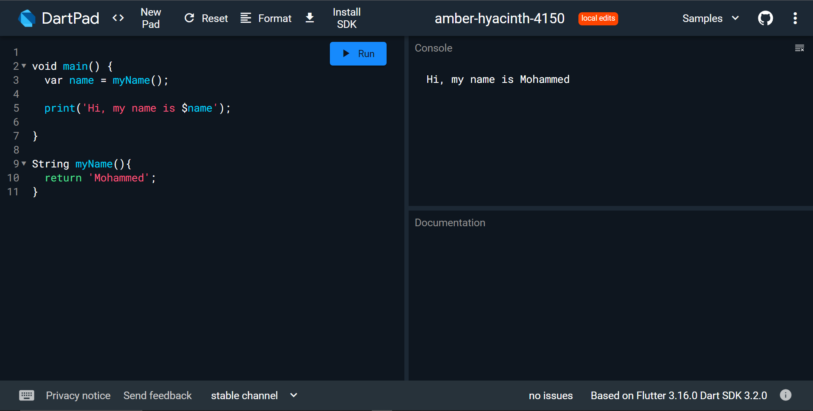
Dart Basics
Notes:
The entry point of a Dart class is the main() method. This method acts as a starting point for Flutter apps as well.

Slide 6
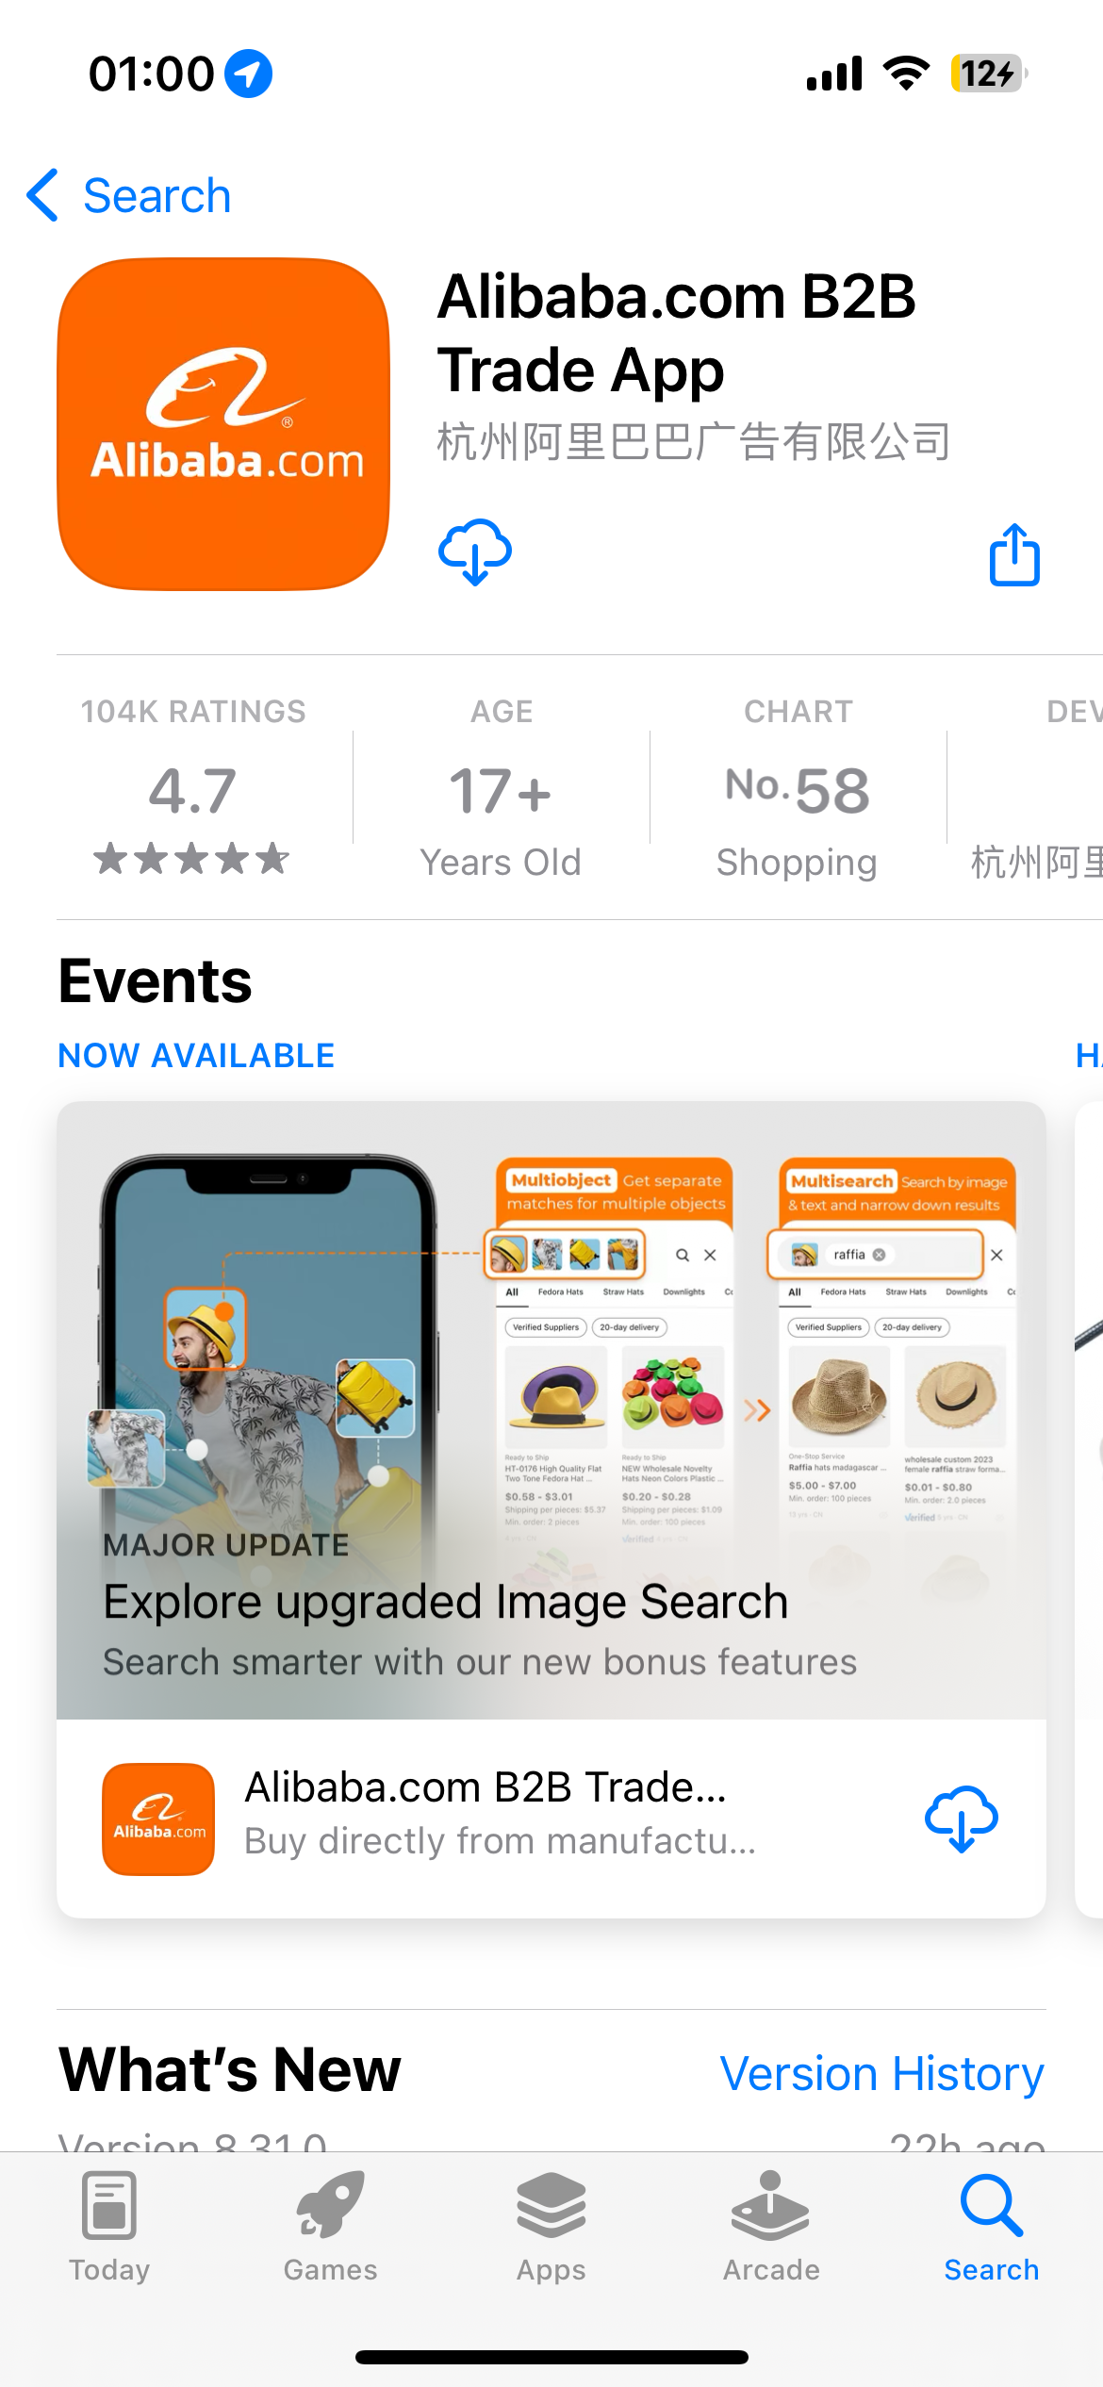
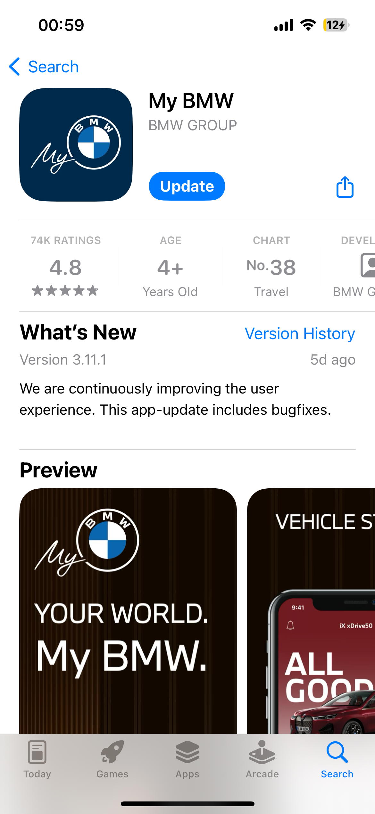
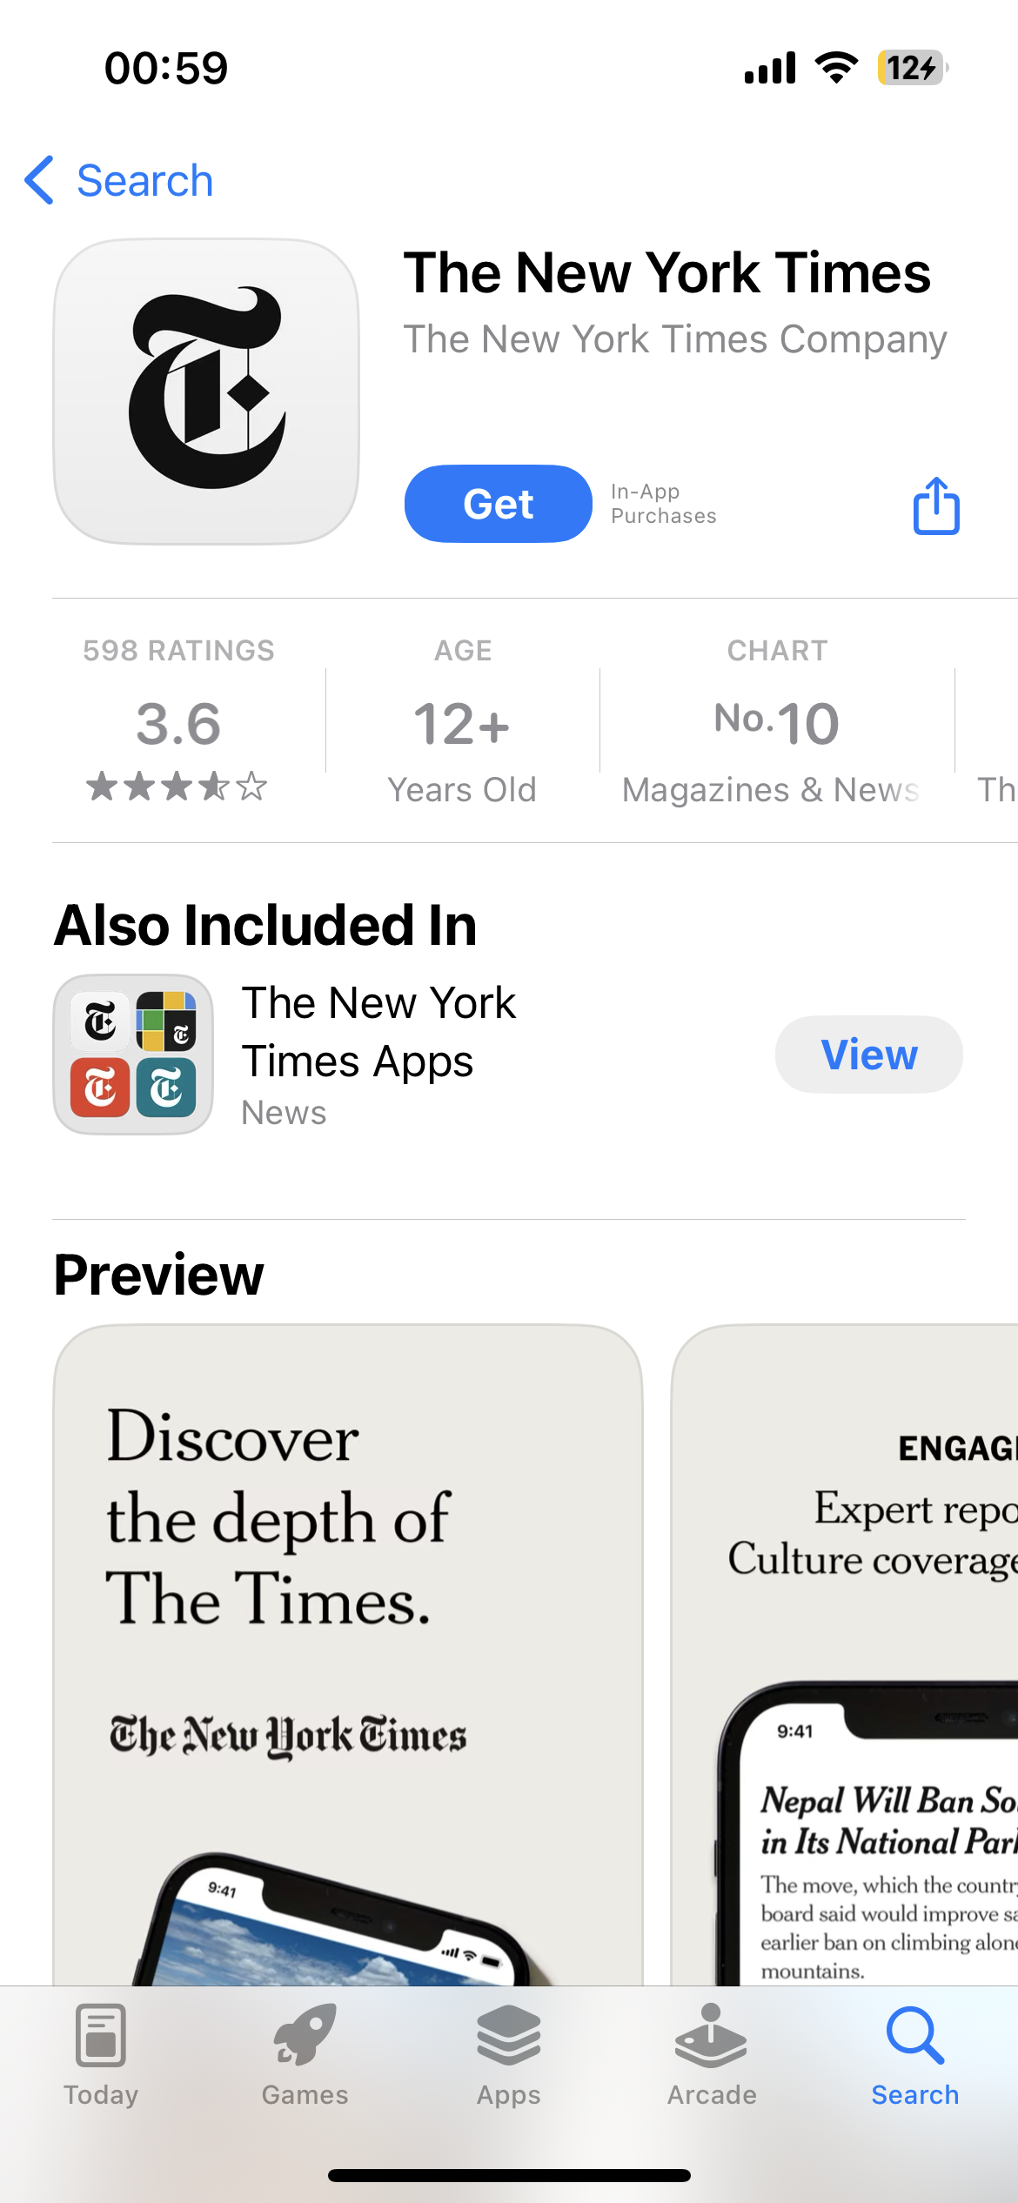
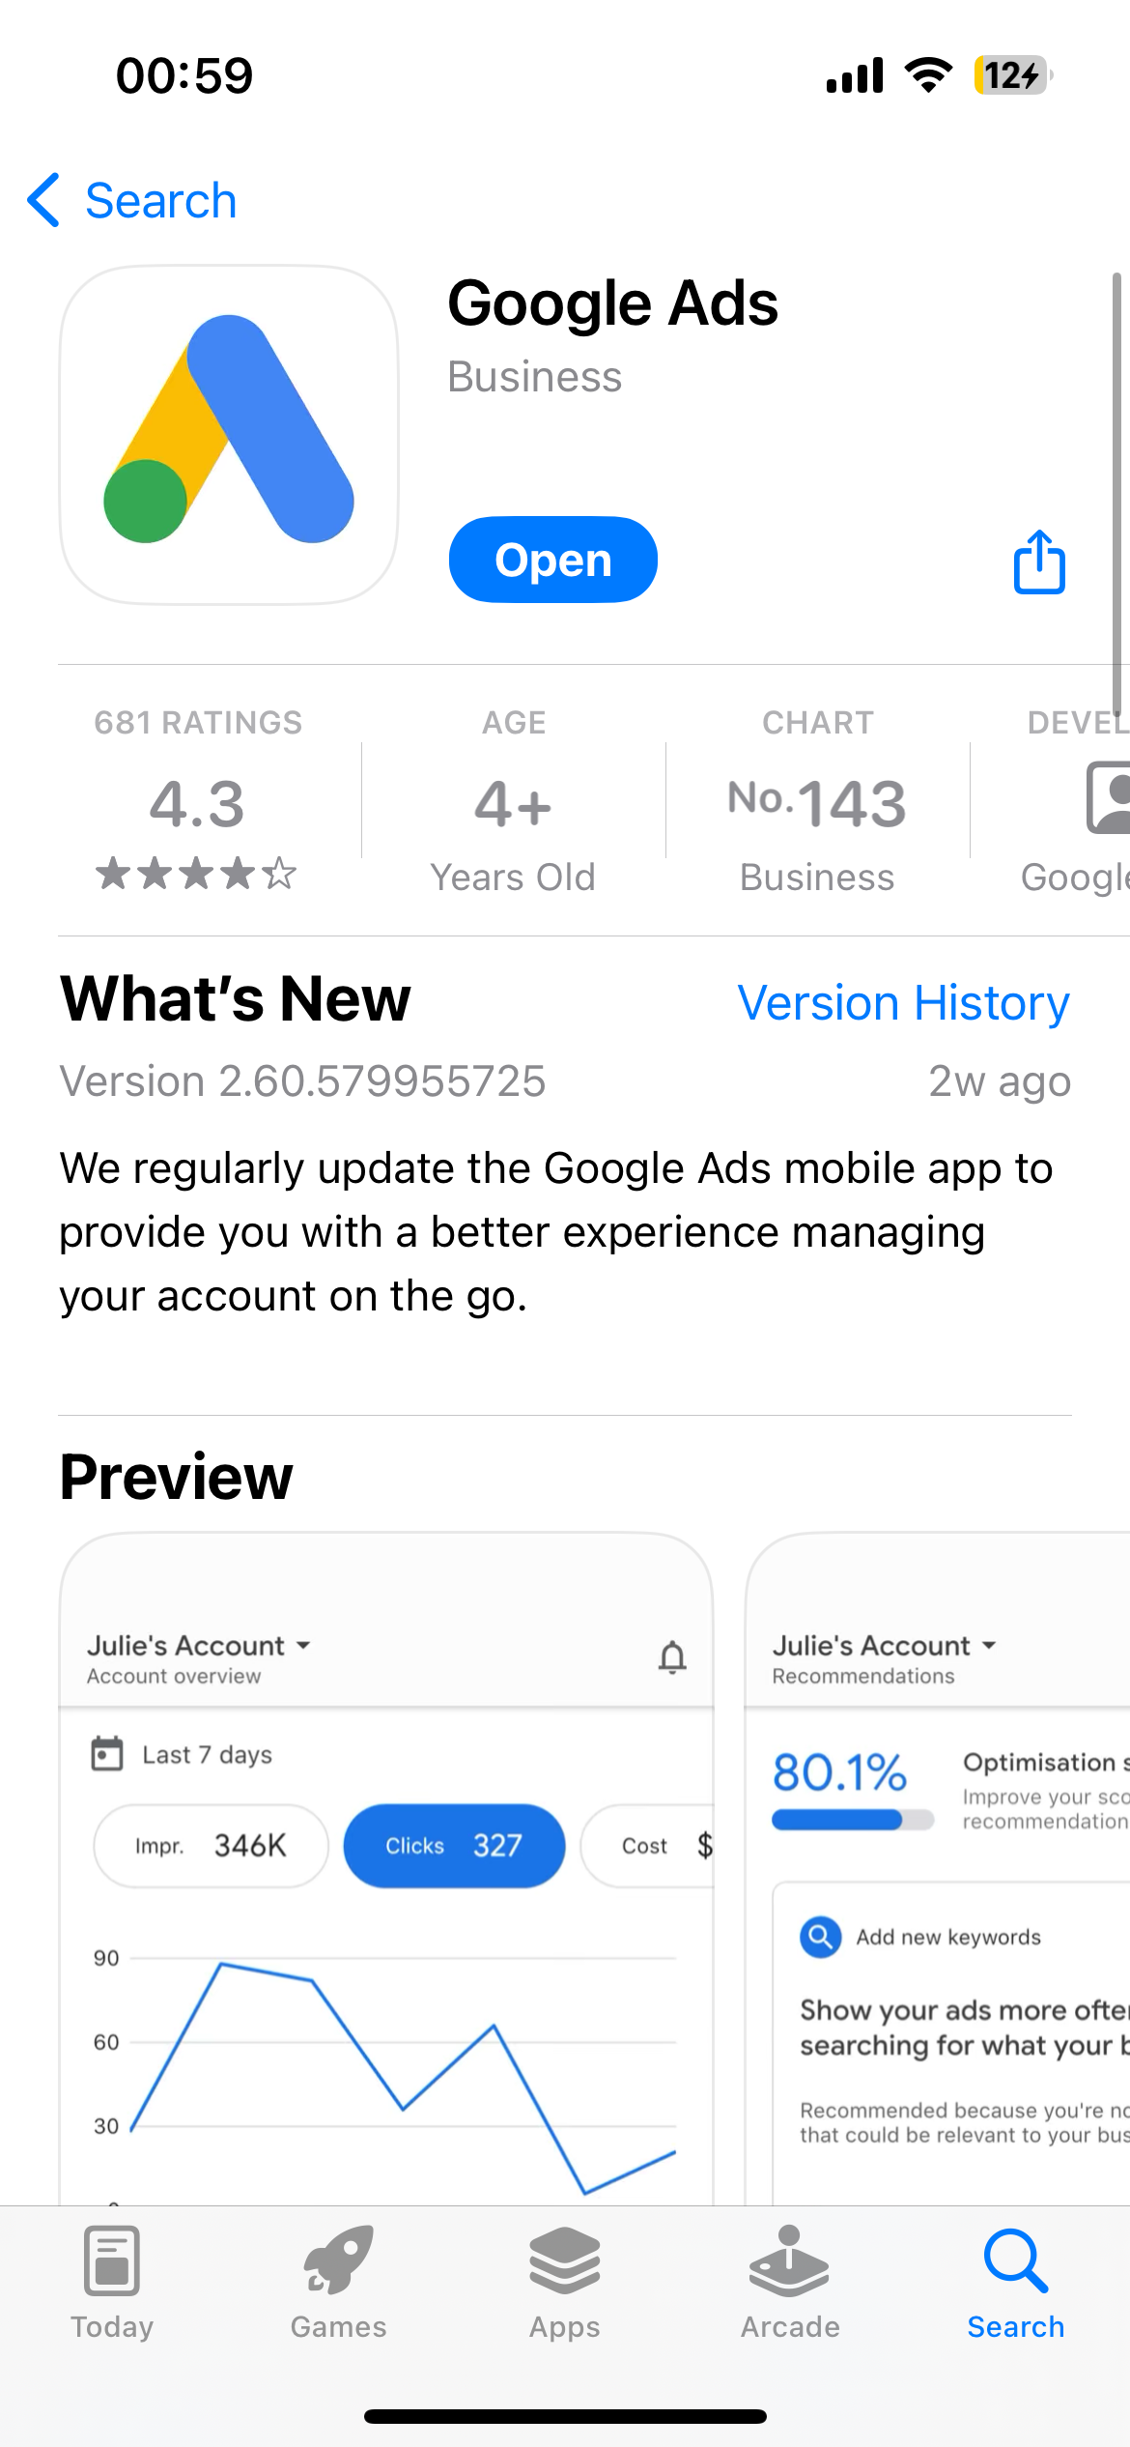
Existing Apps

Slide 7
Why Flutter?
Same codebase for iOS and Android
Modern/Beautiful UI that just works
High Performance Apps
Up to 120 fps
Notes:
Once UI works, it works, and it just keeps on working with. Different OS versions or manufactures (i.e. Samsung or HTC) can’t break it.
Apps feel natural on different platforms

Slide 8
How’s it THAT FAST?
Notes:
Left side is cheap, right side is expensive.

Slide 9
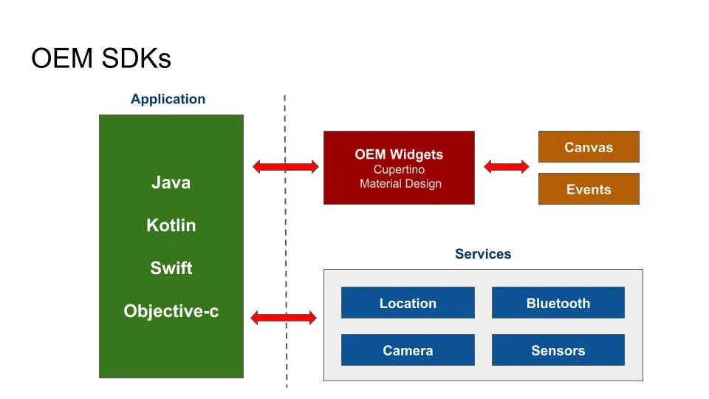
OEM SDK
Notes:
The OEM SDK’s have their apps written in their respective languages.
Then what the app needs from the UI (Cupertino and Material Design) is passed to it and the UI section draws to the canvas, as well as handling other events.
In the case of Android, there is also the JVM to consider but it’s already represented here within the blocks.

Slide 10
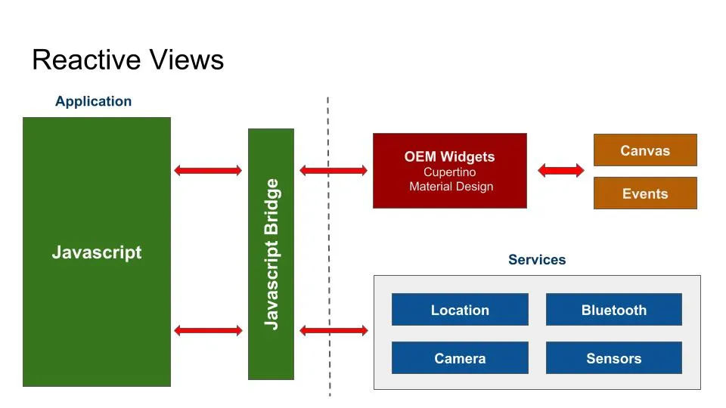
Reactive View
Notes:
Then there are the attempts to create cross platform solutions with Javascript.
The Javascript is translated into something the underlying framework can understand and then that bridge is what talks to the OEM UI.
This extra step of using a bridge take resources and time, impacting performance.

Slide 11
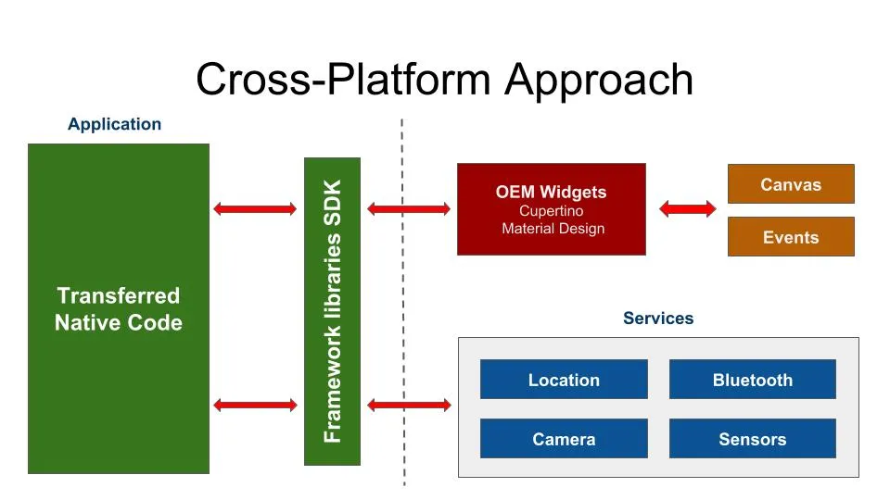
Cross Platform
Notes:
Actual cross platform approaches have their code sent to the SDK libraries, again creating another step that takes time, resources and can adversely impact performance.
Also, like all of the above approaches, they still use the stock OEM UI component system.
This (mostly) limits what you can do to what is available within that UI system.

Slide 12
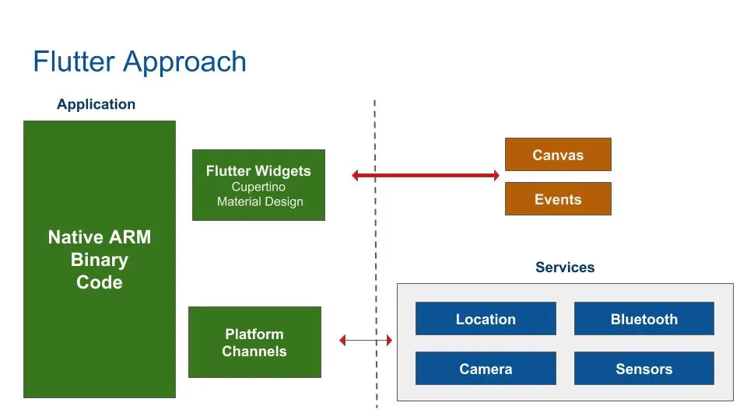
Flutter
Notes:
Then there’s Flutter. The first thing to notice is Flutter uses native ARM binary.
It’s compiled ahead of time, no JVM needed. This means it’s fast. Really fast.
That give you incredible capabilities, as you will see.
Notice how in all the above situations it was the OEM UI systems that talked to the graphics hardware and handled writing to the canvas. But Flutter uses it’s own graphics engine, the Skia engine. That engine is compiled into the app itself, for now. There is talk that a downloadable library including this and other things is in the works, which will allow individual Flutter apps to have a smaller footprint since these things won’t have to be compiled into every app.
Like the rest of the Flutter app, the Skia engine is already compiled to binary;
The secret lies in the fact that, Flutter isn’t using the OEM widget code. Instead, the Flutter framework contains widgets that were made to look exactly like the stock OEM widgets, pixel for pixel.

Slide 13
Widgets
The entire app is a widget
Building block of UI
Can represent:
UI Elements
Layout Elements
New Screens
Notes:
A screen is a widget that contains a widget.
Think of Widgets are building blocks.
Widgets are made by composing basic widgets into more advanced widgets.
UI Elements: Text, Button, BottomNavigationBar etc.
Layout Element: Padding, Stack, Column etc.
New Screen: Activity, ViewController or similar.

Slide 14
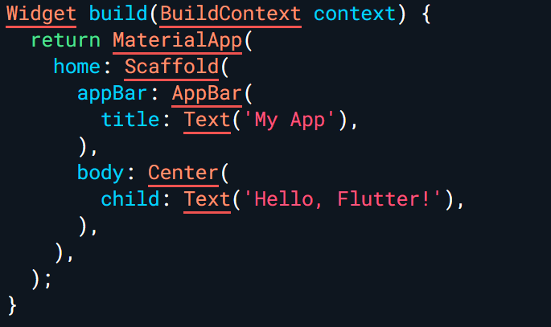
The Widget Tree
Notes:
The widget tree is precisely what it sounds like—a tree structure where each node is a widget. This structure determines how your app's UI is organized and displayed.
Widgets are arranged hierarchically, forming a parent-child relationship.
In this snippet, MaterialApp, Scaffold, AppBar, Center, and Text are all widgets, forming a widget tree.
Widgets Rebuild: When something triggers a change, the affected widgets rebuild.

Slide 15
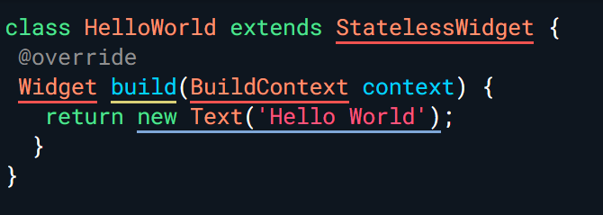
Stateless Widgets
Have no State
Are Immutable
Once created, they don’t change
Notes:
Immutable means that all instances are final.
Used for displaying something that doesn’t change once it’s initialised.
Are useful when the part of the user interface you are describing does not depend on anything other than the configuration information in the object itself and the BuildContext in which the widget is inflated. (= use when you don't need to "update the UI here").

Slide 16
Stateful Widgets
Have a State
Has Mutable Instances
Any changes to State, cause a rebuild
Consume more resources
Notes:
State defines the information on how to interact with the widget in terms of: Behaviour and Layout.
Any changes to the state trigger the widget to rebuild.
A stateful widget is used when some part of the UI must change dynamically during runtime. Stateful widgets can redraw themselves multiple times while the app is running.
It has Mutable Instances that can be read synchronously.

Slide 17
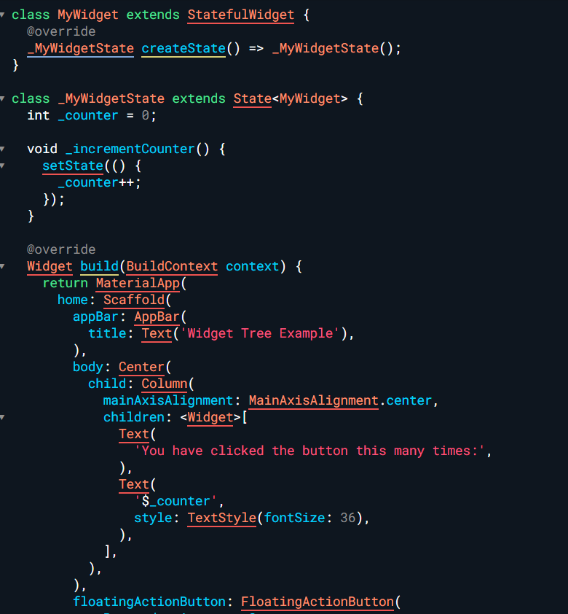
Stateful Widgets
Notes:
Stateful widgets are useful when the part of the UI we are describing changes dynamically.
If we create a button widget that updates itself each time a user clicks that button, that is a stateful widget.

Slide 18
Native Plugins
Can access Native API’s
Official Plugins
Community-based Plugins
Build Custom Plugins
Notes:
A plugin package is a special kind of package that makes platform (phone) functionality available to the app.
For example, a plugin might provide Flutter apps with the ability to use a device’s camera. native Bluetooth, geolocation, sensors within a native phone.
Plugin packages can be written for Android (using Kotlin or Java), iOS (using Swift or Objective-C), web, macOS, Windows, Linux, or any combination thereof.

Slide 19
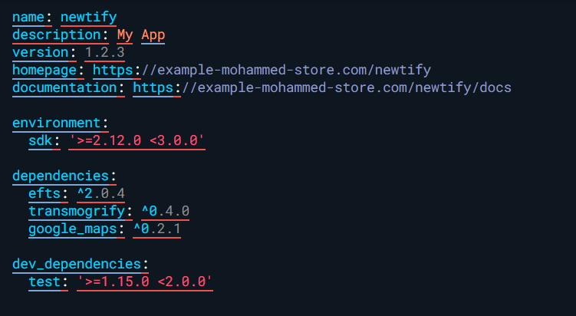
Dependency Management
Quickly add Libraries into your package
Publicly Available
https://pub.dev
Can use Git Repos
Dependency list stored in:
pubspec.yaml file
Notes:
Usually, when building Flutter applications, we require to implement screens with complex components, we could also need to connect to an external database with the data we need for our application.
As developers, we could think about implementing all of these requirements with code built by ourselves, but in reality, this will require time.
Dependency management in Dart is as simple as it can be for developers to quickly implement publicly available libraries into their packages.
Using packages created by other developers to speed up the time it requires from us to develop an application is a common practice.
In addition, it shows how working together, as a community, can help us create solutions to common problems.

Slide 20
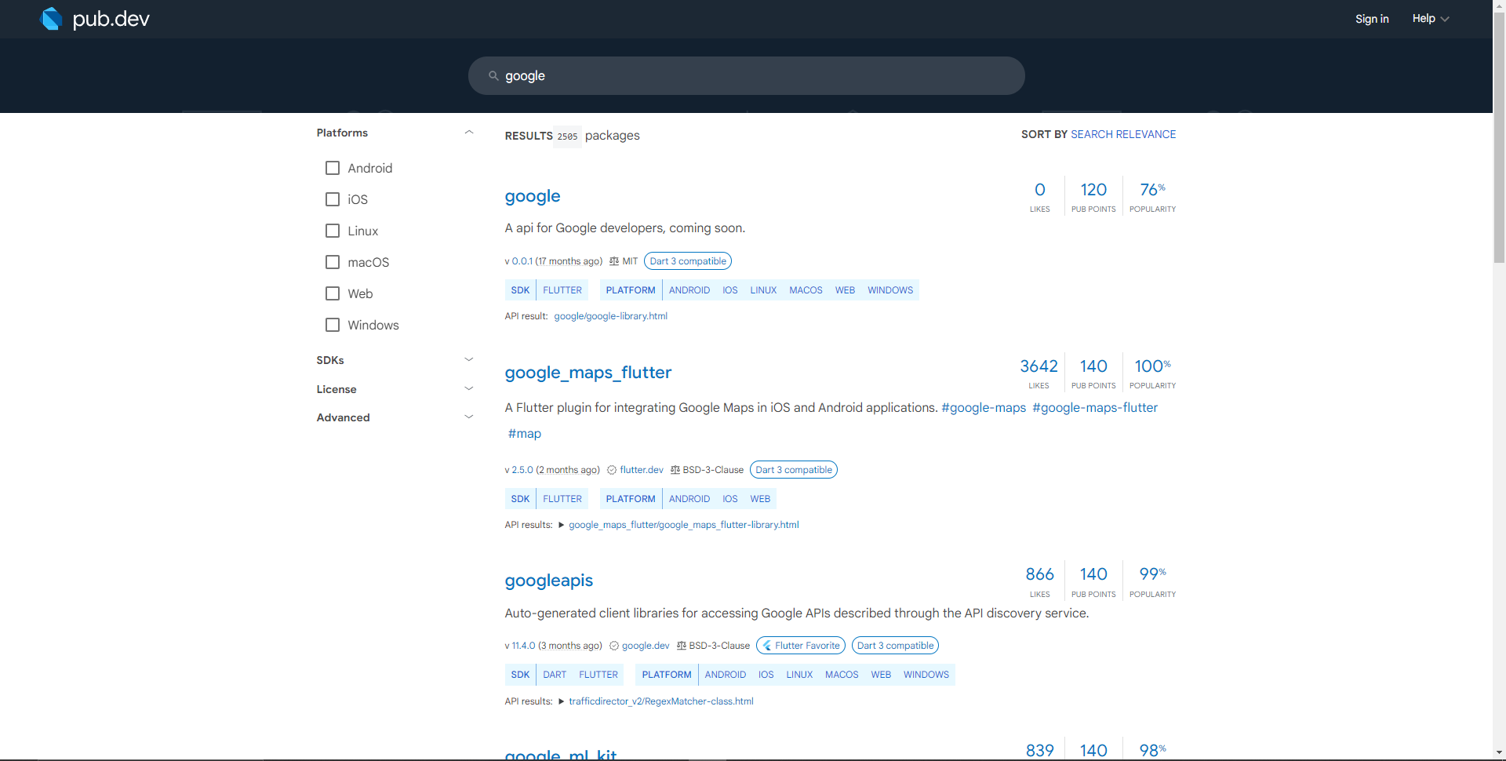
Dependency Management
Notes:
Packages available at https://pub.dev

Slide 21
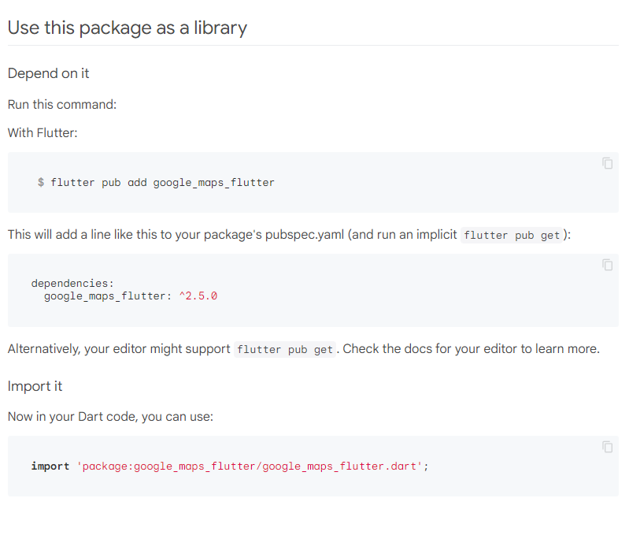
Adding a Library
Notes:
Packages available at https://pub.dev

Slide 22
Thank you

